Slide 1
Boolean Algebra
Logic Circuit
Boolean Algebra
Two Value Boolean Algebra
Boolean Algebra Postulate
Priority Operator
Truth Table & Prove
Duality Principal

Slide 2
Boolean Algebra
Algebra Boolean Basic Theorem
Boolean Function
Invert Function
Standard Form
Minterm & Maxterm
Canonical Forms
Canonical Forms Conversion
Binary functions

Slide 3


Logic Circuit
Logic circuit can be represented by block with inputs on one side and outputs on the other side
Input/output signal is discrete/digital, always represented by two voltage (high voltage/low voltage)
Difference between digital and analog

Slide 4
Logic Circuit
Advantage of Digital Circuit compared to Analog Circuit
  More reliable (simpler circuit, less noise)
  Give accuracy (can be determined)
  But slow response
Main advantage of two-value logic circuit is
  Mathematical model – Boolean Algebra
  Assist in design, analysis, simplify logic circuit

Slide 5
Boolean Algebra (BA)
What is an Algebra? (e.g algebra of integers)
  Set of elements (e.g. 0,1,2,…)
  Set of operations (e.g.+,-,*,…)
  Postulates/axioms (e.g. 0+x=x,…)
Boolean Algebra is taken from George Boole who used BA to study human logical reasoning-calculus proposition
Logic: TRUE or FALSE
Operation: a or b, a and b, not a
Example: If “it touched by the rain” or “poured with water”. “It’s tall” and “broad minded”

Slide 6
Boolean Algebra (BA)
Shannon introduced switch algebra (for two-value Boolean Algebra) for two switch stable representation
a | b | a and b
F | F | F
F | T | F
T | F | F
T | T | T
a | b | a OR b
F | F | F
F | T | T
T | F | T
T | T | T
a | NOT a
F | T
T | F

Slide 7

Two-Value Boolean Algebra
Element Set: {0,1}
Operation Set:{.,+,¬}
Signals: High=5V=1; Low=0V= 0
x | y | x.y
0 | 0 | 0
0 | 1 | 0
1 | 0 | 0
1 | 1 | 1
x | y | x+y
0 | 0 | 0
0 | 1 | 1
1 | 0 | 1
1 | 1 | 1
x | ¬ x
0 | 1
1 | 0

Slide 8
Boolean Algebra Postulate
Algebra Boolean contains element set B, with two operations binary {+} and {.} and operation {‘}
Set B must contain at least element x and y
Closure: For every x, y in B
  x+y is in B
  x.y is in B
Commutative Law: For every x, y in B
  x+y = y+x
  x.y = y.x

Slide 9
Boolean Algebra Postulate
Associative Law: For every x, y, z in B
  (x+y)+z=x+(y+z)=x+y+z
  (x.y).z=x.(y.z)=x.y.z
Identity: (0 and 1)
  0+x=x+0=x for every x in B
  1.x=x.1=x for every x in B
Distributive Law: For every x, y,z in B
  x.(y+z)=(x.y)+(x.z)
  x+(y.z)=(x+y).(x+z)

Slide 10
Boolean Algebra Postulate
Complement: For every x in B, element x’ in B exist for
  x+x’=1
  x.x’=0
  Set B={0,1} and logical operation OR,AND, and NOT must obey all Boolean Algebra postulate.
  Boolean Function mapped several input {0,1} into {0,1} Boolean expression is Boolean statement which contains Boolean operator and variables.

Slide 11
Priority Operator
To reduce the use of bracket in writing Boolean expression, priority operator is used
Priority operator (before and after):’,.,+
Example
a.b+c=(a.b)+c
b’+c=(b’)+c
a+b’.c=a+((b’).c)

Slide 12
Priority Operator
Use bracket to overwrite priority
Example
a.(b+c)
(a+b’)

Slide 13

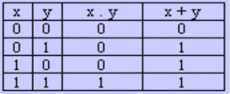
Truth Table (TT)
Prepare list of each combinational input which might come with matched output
Example (2 input, 2 output)

Slide 14
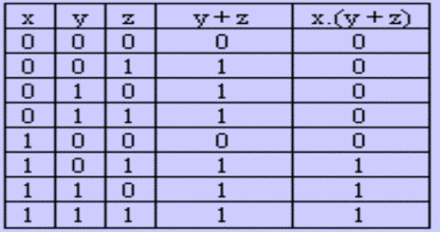
Truth Table (TT)
Example (3 input, 2 output)

Slide 15
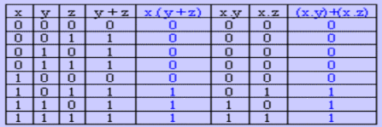
Proving Using TT
Can use TT for proving
Prove:x.(y+z)=(x.y)+(x.z)
  Build TT for left and right expression
  Is left=right? If yes, the equation is true

Slide 16
Duality Principal
Duality principal – each Boolean expression will be certified if identity of operators and elements are interchangeable
+ ↔.
1 ↔ 0
Example: Given expression
a+(b.c)=(a+b).(b+c)
therefore duality expression is
a.(b+c)=(a.b)+(b.c)

Slide 17
Duality Principal
Duality principal give free theorem “buy one, free one”. You only need to prove one theorem and get another one free.
If (x+y+z)’=x’.y’.z’ is certified, therefore the duality is also certified (x.y.z)’=x’+y’+z’
If x+1=1 is certified, therefore the duality is also certified x.0=0

Slide 18
Boolean Algebra: Basic Theorem
Apart from the postulate, there are useful several theorem
Idempotency
a) x+x=x b)x.x=x
Prove:
x+x = (x+x).1 (identity)
= (x+x).(x+x’) (complement)
= x+x.x’ (distributive)
= x+0 (complement)
= x (identity)

Slide 19
Boolean Algebra: Basic Theorem
NULL element for + and . operator
a) x+1=1 b) x.0=0
Involution (x’)’=x
Absorption
a) x+x.y=x b) x.(x+y)=x
Absorption (variant)
a) x+x’.y=x+y b) x.(x’+y)=x.y

Slide 20
Boolean Algebra: Basic Theorem
DeMorgan
a) (x+y)’=x’.y’ b) (x.y)’=x’+y’
Consensus
a) x.y+x’.z+yz=x.y+x’.z
b) (x+y).(x’+z).(y+z)=(x+y).(x’+z)

Slide 21
Boolean Algebra: Basic Theorem
Theorem can be proven using TT method. (Exercise: Prove DeMorgan Theorem using TT)
It can also be proven from algebra manipulation process using postulate or other basic theorem

Slide 22
Boolean Algebra: Basic Theorem
Theorem 4a (absorption) can be proven with
x+x.y = x.1+x.y (identity)
= x.(1+y) (distributive)
= x.(y+1) (interchange)
= x.1 (theorem 2a)
= x (identity)
With duality, theorem 4b
x.(x+y)=x
Try to prove theorem 4b using algebra manipulation method

